Slide 1
Andrew’s (mega scuffed) guide to Git & setting up for final projects

Slide 2
Structure
This got really long, so here’s a table of contents kinda (in terms of slide number):
5-7 Install VSCode & Git
8-10 Install Python
11 Checkpoint
12-13 GitHub
14-15 Git/Python configuration
16 Checkpoint
17-19 GitHub setup
20 Checkpoint
21-28 Creating GitHub repository
29-30 Git basics
31-33 Git example
34-36 GitHub collaborators
37 Git tips
38 Git branches
39 Extra tools
(Important ones in bold)

Slide 3
Git? Quoi?
Git is a Version Control system. It allows you to save, log, rollback and combine progress on projects.
Git is awesome, here are just a few reasons:
It will be useful in all future CS courses or any programming you do
It allows multiple users to work on the same code effectively
It allows you to save your progress at points when you have functioning code
It allows you to log comments whenever you make progress

Slide 4


Overview
Git doesn’t work in Codespaces (because secretly you’ve been using it the whole time, CS50 has been doing this for you, but it doesn’t allow multiple user access, or for you to do anything manually yourself).
We are going to set it up in a new (but really the same) IDE (integrated Development Environment, you will recognize this when you see it don’t worry). So overall we need to install the following to use Git:
Git
VSCode

Slide 5
Git/VSCode installation
Follow the instructions here to install Git
Follow the instructions here to install VSCode
This is actually already enough to get going, but we are going to setup a number of other tools to help ourselves out.
Please follow the instructions to check that git is installed (run git version in the terminal, it should give something like: git version 2.35.1.windows.2)
Note: On Mac you may need to CTRL + Click on the .pkg file to install – Mac doesn’t trust the file for some reason. Make sure you install the latest version (the website sometimes gives the wrong version as the latest, it should be 2.33 I believe).

Slide 6
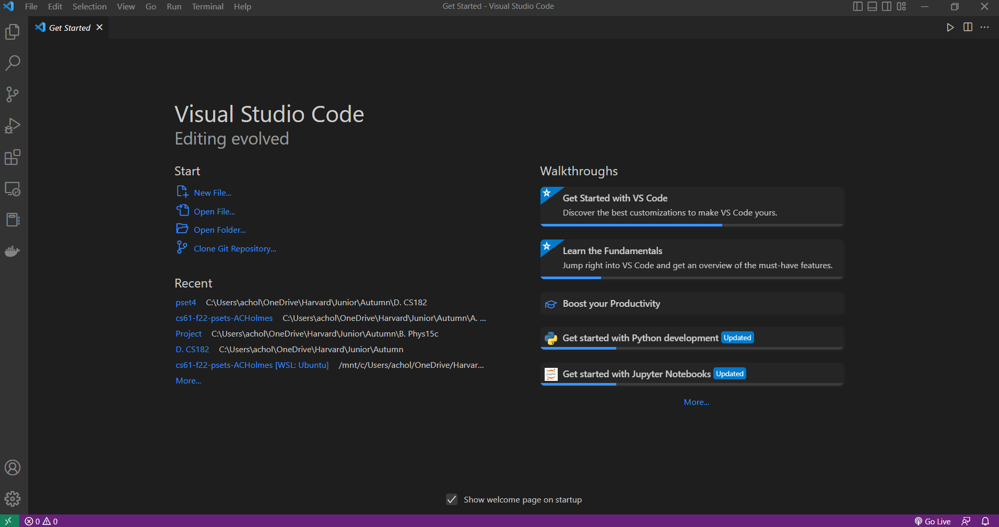
What you should have so far
Opening VSCode should look something like this:
This should look somewhat familiar!

Slide 7
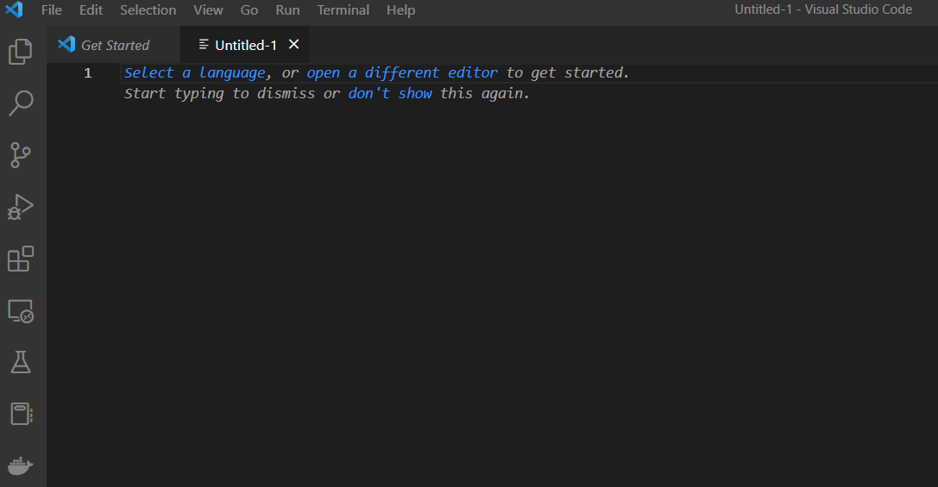
VSCode setup
With VSCode installed, you can now write code like you would in Codespaces. For example, hit ‘File -> New File’ in the top left and create a txt file.
Select Python as your language and write code that should print “Hello World”, and save the file as hello.py
To run this in Codespaces, we used the terminal to run this with ‘python hello.py’. If you try this on Windows it will fail, saying you do not have Python installed. It may work on Mac as it comes with Python, but it too is missing a bunch of things you may need for your final project (e.g. flask).

Slide 8
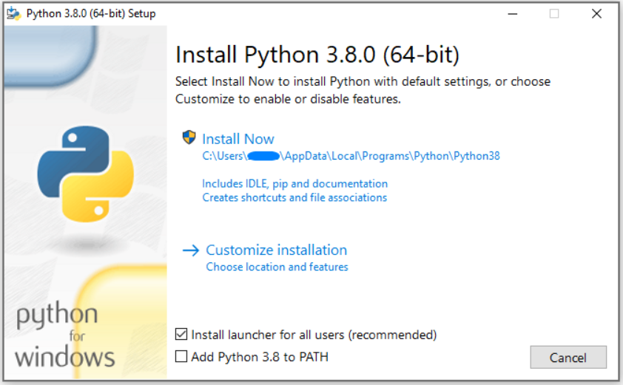
Python installation
Even if you are on Mac, I recommend installing Python again. Macs ship with Python 2.7, which is well out of date. To install Python, follow the instructions here
If on Windows, please tick the ‘add to PATH’ option. If you forget to do this, please see the next slide.

Slide 9
Adding Python to PATH (Windows only)
If you are on Windows, you may need to add Python to your environment variables. You can follow the instructions here or with more images here.
This can be kind of annoying, so if stuck please Slack me :)

Slide 10
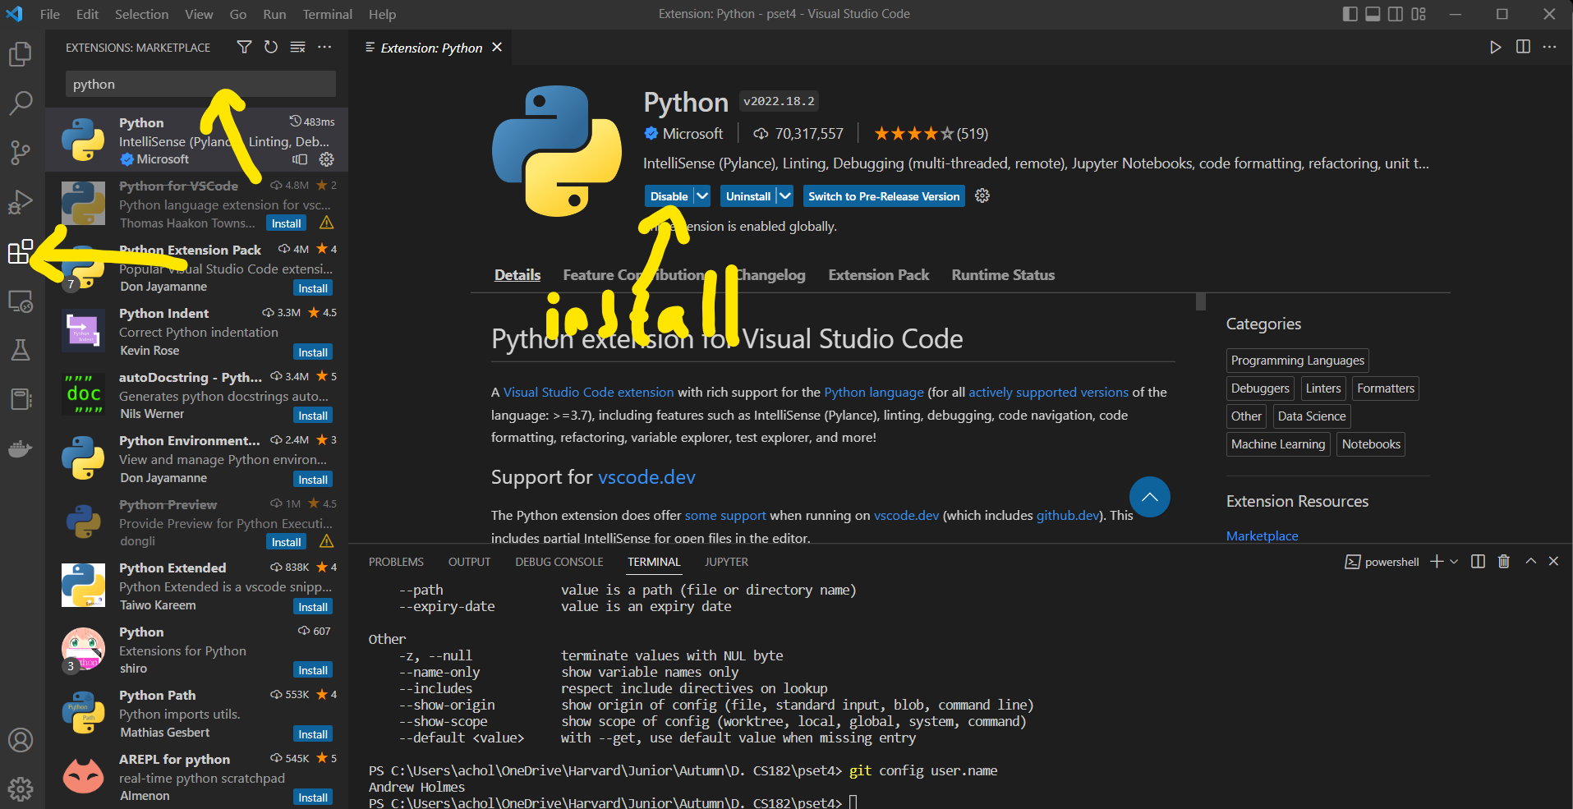
Final Python steps
Finally, we should install the Python extension in VSCode (follow image on the right).
Then we should check quickly that VSCode will use the correct installation. To do so:
open VSCode and hit CTRL + SHIFT + P
Write: ‘Python: Select Interpreter’
Select the option that includes ‘Python 3.x…’

Slide 11
Where we are (1)
At this point you should have:
Installed Git. This will allow us to use Version Control
Installed VSCode. This will allow us to write code!
Installed Python. This will allow us to execute Python code!
To check that these all work:
Open a terminal/command line (can do this in VSCode if you want)
Type ‘python’ and hit enter. Some text about Python should display, and the prompt should change. You can now run a command (e.g. print(“Hello World!”). To exit this prompt, write ‘quit()’ and hit enter.
Type ‘git --version’ and hit enter. You should get a version number

Slide 12

GitHub
If you’ve heard of Git, you’ve probably heard of GitHub.
While Git alone is powerful, using a service like GitHub gives us a number of other benefits – for example, we can host different versions of our code online and control access to who can see and/or edit our project and more.
You can use GitHub online or download GitHub desktop. Either is fine, but I (and most) just use the website.

Slide 13
GitHub setup
Go to GitHub and create an account!
We will come back to this shortly!

Slide 14
Configuring Python
We often use a variety of packages when working in Python. One obvious one that many of you will use for your final projects is Flask. We need to install this so we can use it. To install Python packages, we use pip, a package manager (which was installed for you when you installed Python).
First, best to update pip to its latest version:
‘pip3 install --upgrade pip’
Then to install Flask, run:
‘pip3 install flask’
You can install essentially any Python package this way. To see which packages you have installed, you can run ‘pip3 list’. I use pip3 here as if on Mac, using pip may install things for your python 2.7 installation of Python, which is not what you want.

Slide 15
Configuring Git
Git requires some initial configuration to get working. You will want to set your name and email address, as it uses these to determine who contributed to a commit (more on what that means later). To set this up, run the following in your terminal (one at a time):
git config --global user.name “Your name“
git config --global user.email youremail@example.com

Slide 16
Where we are (2)
At this point you should have:
Installed Git. This will allow us to use Version Control
Installed VSCode. This will allow us to write code!
Installed Python. This will allow us to execute Python code!
Created a GitHub account. This will allow us to control our code versions online and collaborate with others
Installed Flask
Configured Git

Slide 17
Configuring Git & GitHub
We now want to tie our Git and GitHub together. This will allow us to collaborate with others by uploading the code we have written when we finished to the online repository (think folder), that our partner can then pull from the website onto their computer to keep working on.
To do so, you will need to follow these instructions to add an SSH key to your GitHub. This will essentially give your laptop permission to send data to your GitHub account’s respositories (folders).
There is a walkthrough of what to do on the following two slides which hopefully may be clearer than the website instructions.

Slide 18
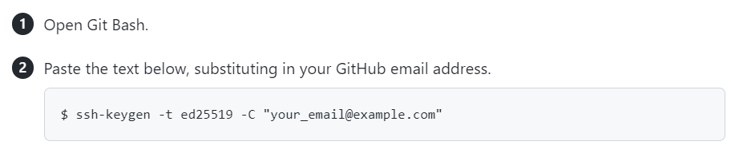
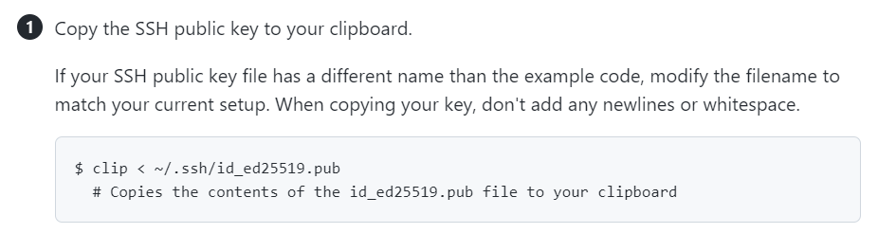
Setting up GitHub (1)
(Terminal in VSCode works just as well as Git Bash)
Then just set no passphrase when asked.

Slide 19
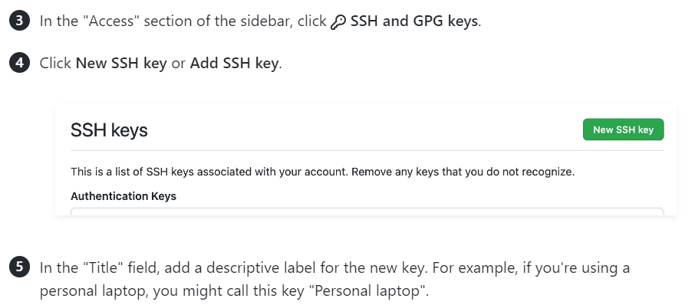

Setting up GitHub (2)
Go to GitHub, click the icon in the top right and find ‘Settings’
Leave Key Type as ‘Authentication’
Hit ‘Add SSH Key’

Slide 20
Where we are (3)
At this point you should have:
Installed Git. This will allow us to use Version Control
Installed VSCode. This will allow us to write code!
Installed Python. This will allow us to execute Python code!
Created a GitHub account. This will allow us to control our code versions online and collaborate with others
Installed Flask
Configured Git
Created a setup an SSH Key to allow us to push and pull from GitHub

Slide 21
Creating our first GitHub repository

Slide 22
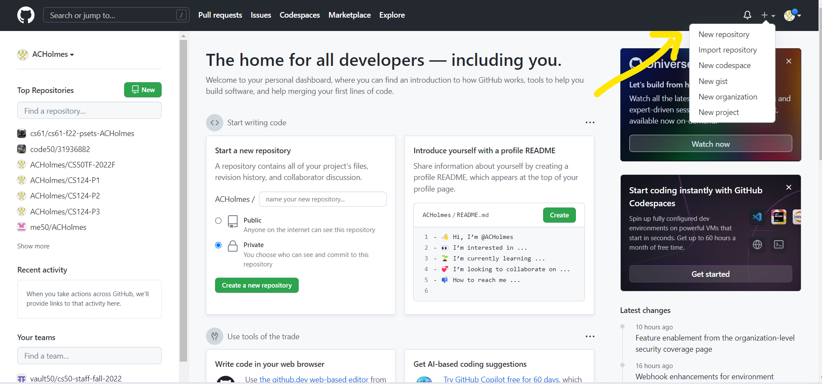
1: Create a repository
To setup a project, for now I recommend doing the following:
Go to GitHub and create a new repository

Slide 23
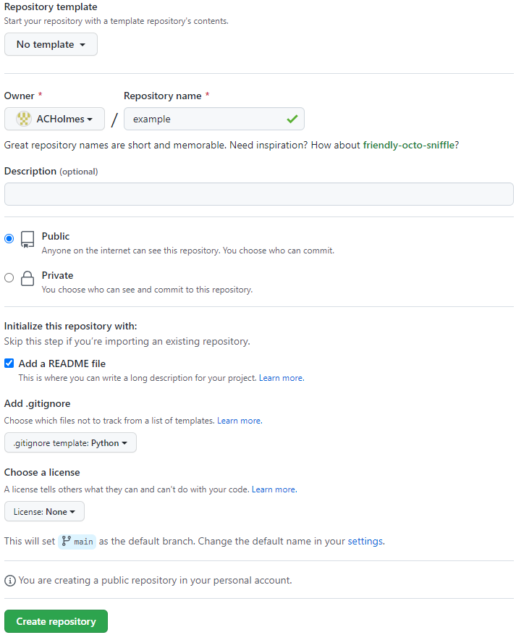
2: Setup repository
Give your repository a name (whatever your project is called), leave it as public, add a README file (and optionally a .gitignore file using an appropriate template). The owner should be your GitHub username.

Slide 24
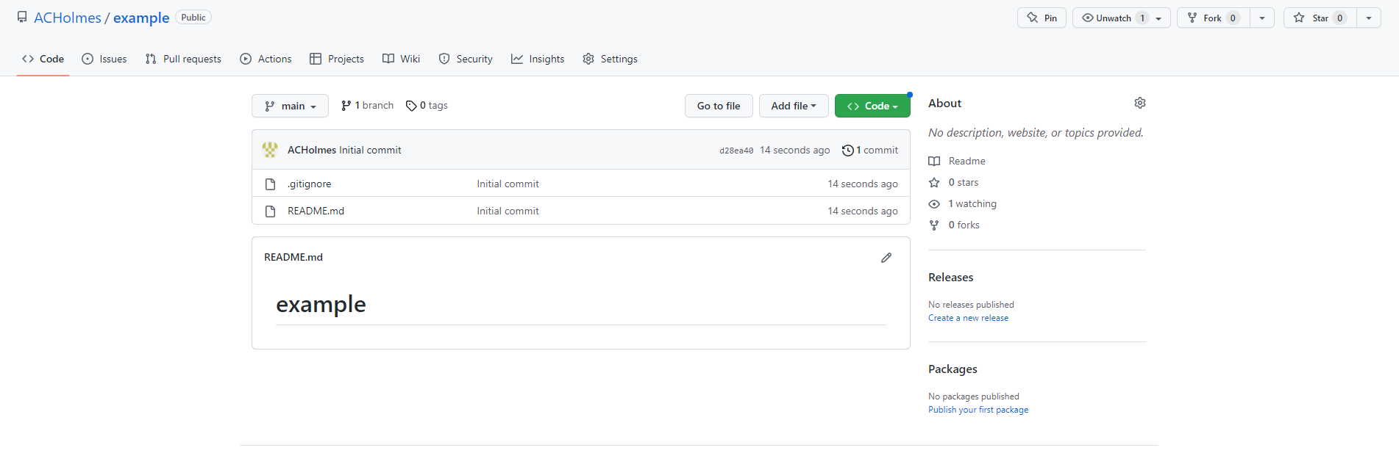
Result

Slide 25
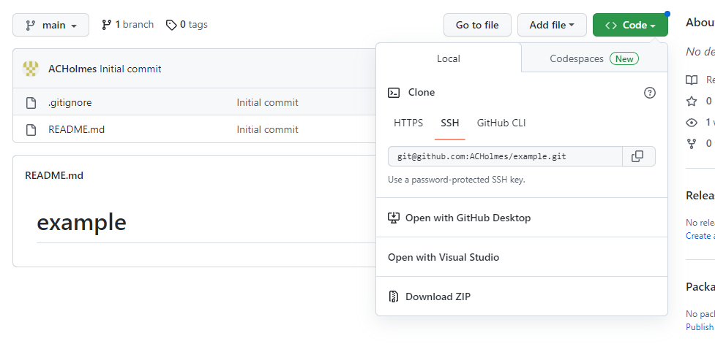
3: Clone repository
Hit the green ‘Code’ button, make sure you are on SSH and copy the text in the box (git@github.com:ACHolmes/example.git in this image)

Slide 26
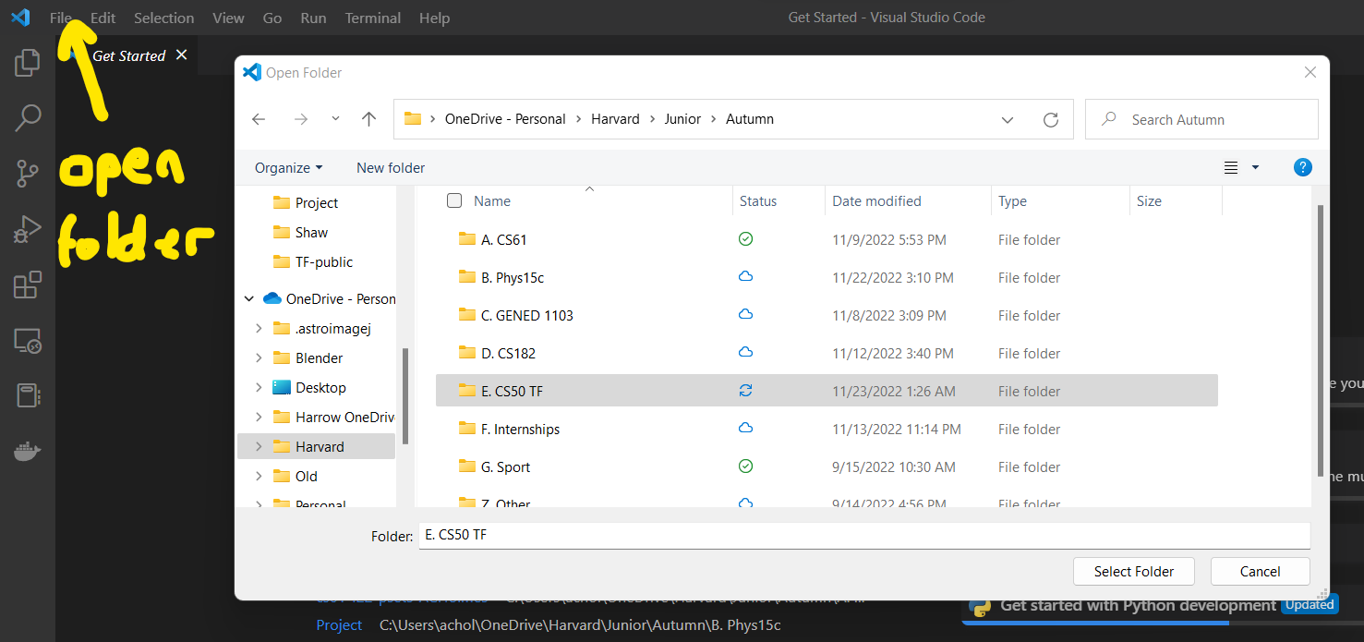
4: Find the folder
Find where you want to keep your project on your laptop. For me, that might be in my CS50 TF folder. So I open that folder in VSCode (can do this step in terminal/Git Bash too)

Slide 27
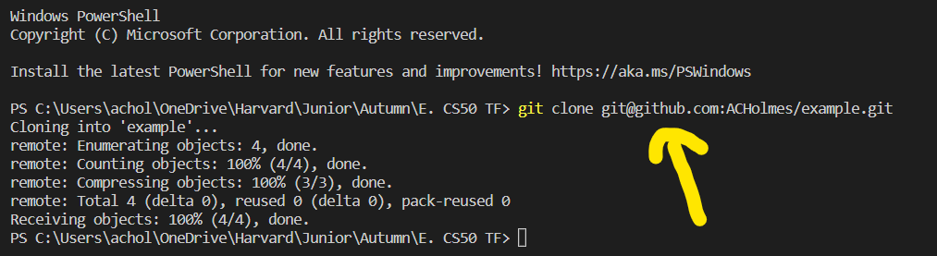
5: Clone repository
Run ‘git clone <link you copied>’

Slide 28
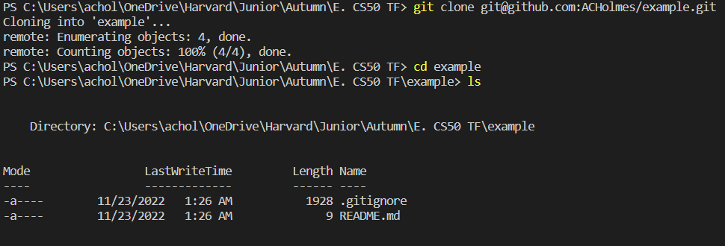
6: Work in that folder!
We see now that if I ‘cd’ into that folder, the files are there!

Slide 29
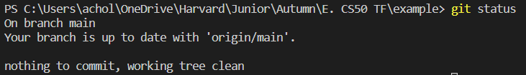
Git basics
There are a few basic commands that I think you should know:
git status – Tells you information about how up-to-date your version of the code is versus what is uploaded on GitHub
2. Git add – This adds a file to tracking. For example, git add hello.py would mean that Git will now keep track of this file. You can add all files using git add *

Slide 30
Git basics
3. Git commit – This creates a commit, or something like a checkpoint of the current state of our folder.
4. Git push – This pushes the latest commit (think checkpoint) to GitHub so that it is stored safely online. This also allows your partner to take the latest version so that they can continue your work.
5. Git pull – the opposite of git push, pulls the latest commit from GitHub to your computer.

Slide 31
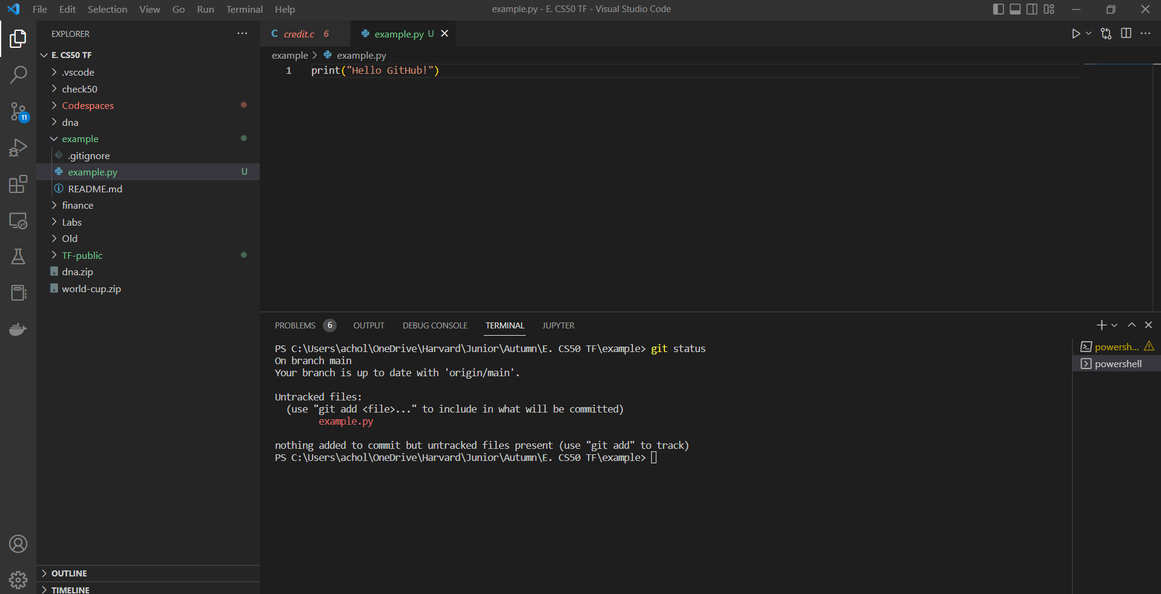
Git example (1)
I’ve added a file, example.py, which is just a simple python file. Running git status I see it is ‘untracked’.
This means if I try to commit, it won’t do anything as nothing has changed (Git is not tracking this file, so it doesn’t know it has been modified). To fix this, run git add *.

Slide 32
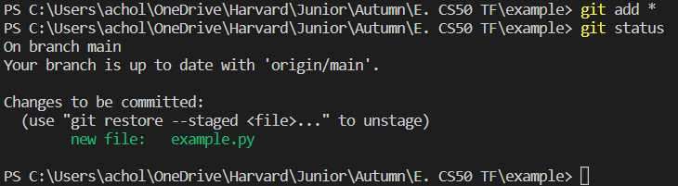
Git example (2)
Running git add * followed by git status we see this file is now tracked. I want to commit this change (make a checkpoint). Let’s use git commit. There’s a few ways of doing this, but for now I recommend git commit –am “message here”
This commits all tracked files, with the message in the quotes that follow it (-am for ‘all’ and ‘message’):
We see that git logs the message we gave it, along with realizing that we created a new file (example.py)

Slide 33
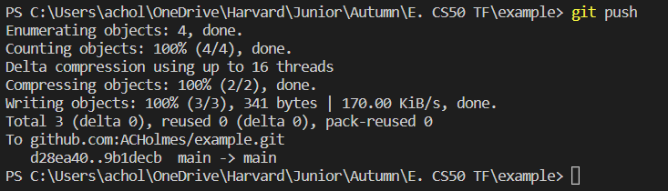
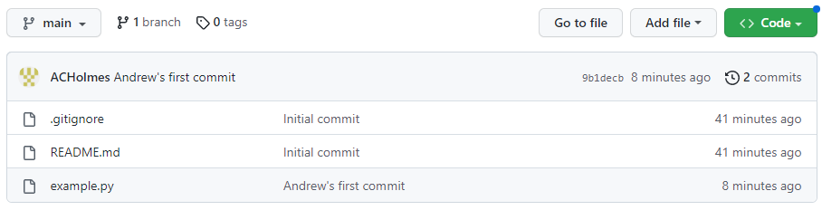
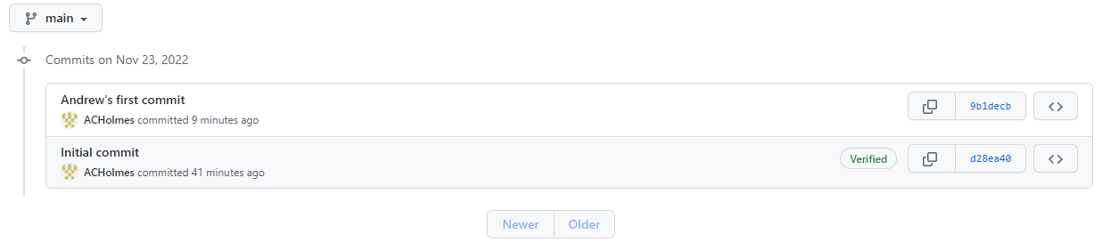
Git example (3)
Finally, let’s run git push to push this commit up to the GitHub repository:
We can hit this button to see a list of commits to the repo.
We can now see our example.py on GitHub, along with the message from the last commit it was updated in.

Slide 34
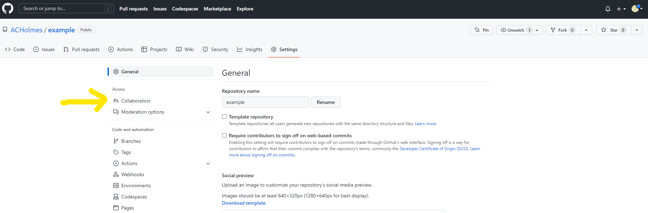
GitHub: Adding Collaborators
Head to the settings page in your repository, and click ‘collaborators’. You will generally need to enter your GitHub password again to proceed here.

Slide 35
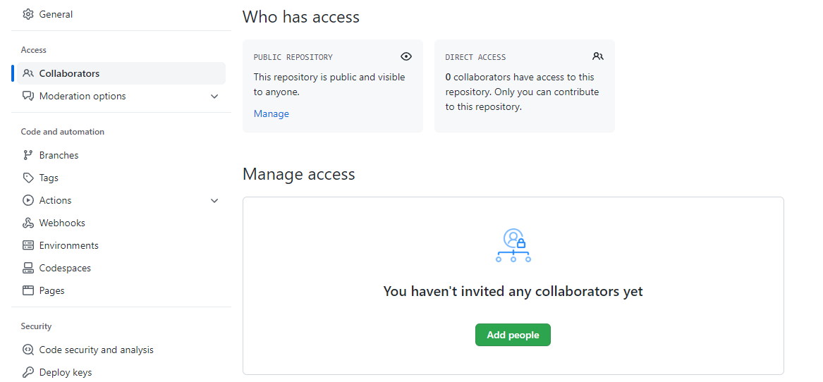
GitHub: Adding Collaborators
Hit the ‘Add people’ button and add your partners’ GitHub usernames (or the email addresses they used to sign up to GitHub)

Slide 36
GitHub: Collaboration
Everyone should receive an email that should give them access to the repository. They will then be able to clone, commit, push and pull from the repo like you can.
If in Andrew’s lab, please also add me as a collaborator – I won’t edit your code, but it will mean I can see the latest version of your project at any time, which will be super helpful if you get stuck so that I can look at your code, and can quickly download and run it myself by cloning it :)

Slide 37
Git tips
When working in a group, best to always:
Commit and push when you finish working on something (especially if you think you’re going to make changes/write more code that might break things, when you’ve got something working, commit! Mark that checkpoint, and push it so that everyone can use it)
Pull whenever you are about to start working. This helps ensure you are working on the latest version of the project, so any work other members have done will be updated in your local copy.
Leave good commit messages to help yourself and others keep track of what you did.

Slide 38
Branches
Ideally, using branches is good practice, but this may be too complicated for now. If you’d like to learn about branches or think you’re up for it, here’s how:
So far, we’ve been using just the one branch (called ‘main’)
To create a new branch, you can use git branch branchname, or I generally use git checkout –b branchname
git checkout switches you to another branch. The –b from above creates a branch and switches you to that branch in one go.
This allows you to work on a part of the project in isolation without disturbing the main body of code. Once it is ready, you can merge branches.
To merge a branch into the main branch, make sure you have committed all the work, and then git checkout main to switch back to the main branch, and run git merge branchname to merge that branch into the main branch.

Slide 39
Other useful tools
The live server plugin in VSCode will let you live preview websites (using HTML/CSS/JS rather than Flask). Once installed, a ‘Go Live’ button will appear in the bottom right of VSCode – click it to start up the live preview.
If you are writing a project in C, you will need to install a C compiler to be able to compile your code! On Windows I recommend GCC, Mac comes with the C compiler clang pre-installed.
Some things are far easier to install or work with in Linux. On Windows you can use WSL (Windows Subsystem for Linux) to run a Linux subsystem (99% of projects shouldn’t need this, but it certainly can be useful)
Several others I can’t think of right now because I’ve been making these slides far too long lol. Maybe more to come later, think this is long enough for now!

